Slide 1
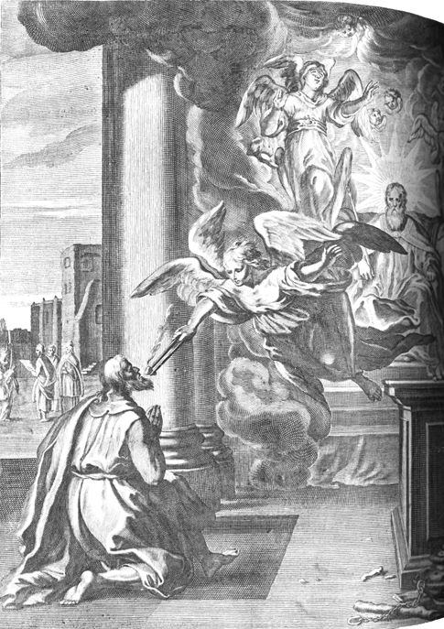
The Book of Isaiah

Slide 2
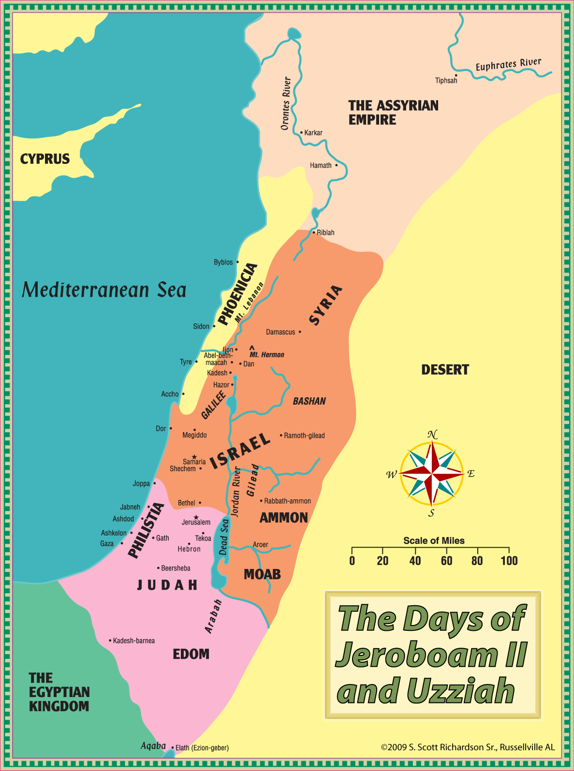

Slide 3
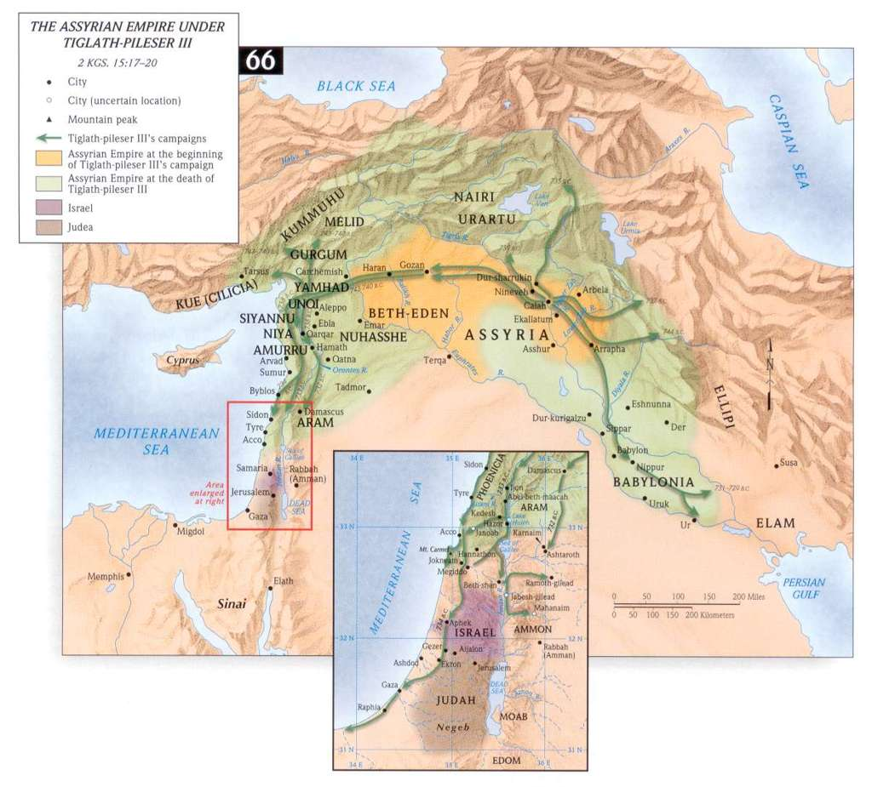

Slide 4
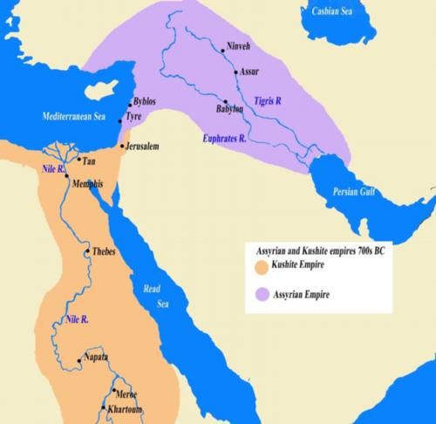

Slide 5
Assyrian Psychological Warfare
'With battle and slaughter I stormed the city and captured it, 3,000 of their warriors I put to the sword;
their spoils and their possessions, their cattle and sheep I carried off.
Many captives from among them I burned with fire, and many I took as living captives.
From some I cut off their hands and their fingers, and from others I cut off their noses and their ears.
I put out the eyes of many.
I made one pillar of the living, and another of heads, and I bound their heads to posts round about the city.
Their young men and maidens I burned in the fire, the city I destroyed,
I devastated, I burned it with fire and consumed it.

Slide 6
Assyrian Psychological Warfare
I took the city, and 800 of their fighting men I put to the sword, and cut off their heads.
Multitudes I captured alive, and the rest of them I burned with fire, and carried off their heavy spoil.
I formed a pillar of the living and of heads over against his city gate and 700 men I impaled on stakes over against their city gate.
The city I destroyed, I devastated, and I turned it into a mound and ruined heap.
Their young men and maidens I burned in the fire.'

Slide 7
Assyrian Psychological Warfare
“I cut off their heads and formed them into pillars”
“Bubo, son of Buba, I flayed in the city of Arbela and I spread his skin upon the city wall”
“I flayed all the chief men who had revolted, and I covered the pillar with their skins”
“Many within the border of my own land I flayed, and spread their skins upon the walls”
“Their corpses I formed into pillars”
“From son I cut off their hands and their fingers, and from other I cut off their noses, their ears, and their fingers, of many I put out their eyes”
“I made one pillar of the living, and another of heads, I bound their heads to posts round about the city”

Slide 8
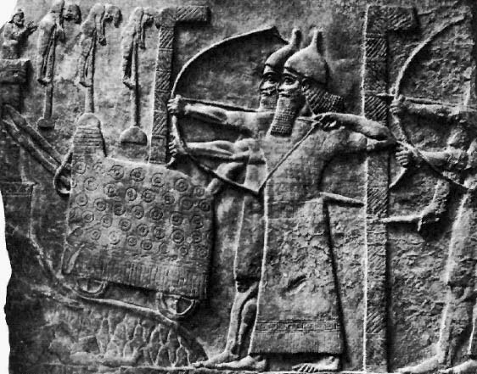
Assyrian Psychological Warfare

Slide 9
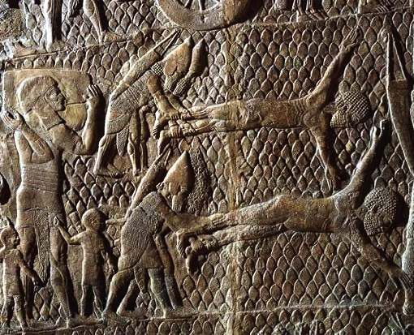
Assyrian Psychological Warfare

Slide 10
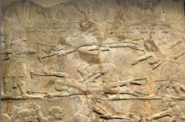
Assyrian Psychological Warfare

Slide 11
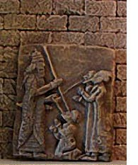
Assyrian Psychological Warfare

Slide 12
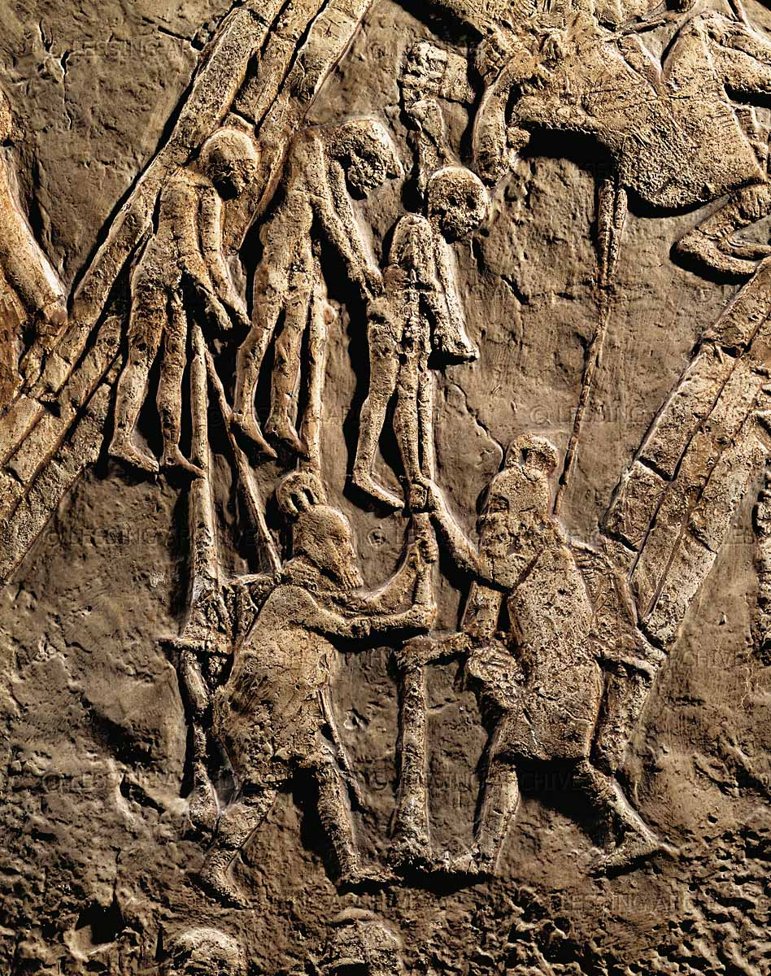
Assyrian Psychological Warfare
Notes:
From the siege at Lachish in 701 B.C.

